Slide 1
Unit 2 Food Supply Chain and Sustainability

Slide 2
Unit Introduction The Food Supply Chain
This introduces the food chain by;
Defining the food supply chain
Explaining the concept ‘From Sea and Farm to Fork’
Describing the key elements of sustainable food production
Explaining the benefits of sustainable food production for Catering operations

Slide 3
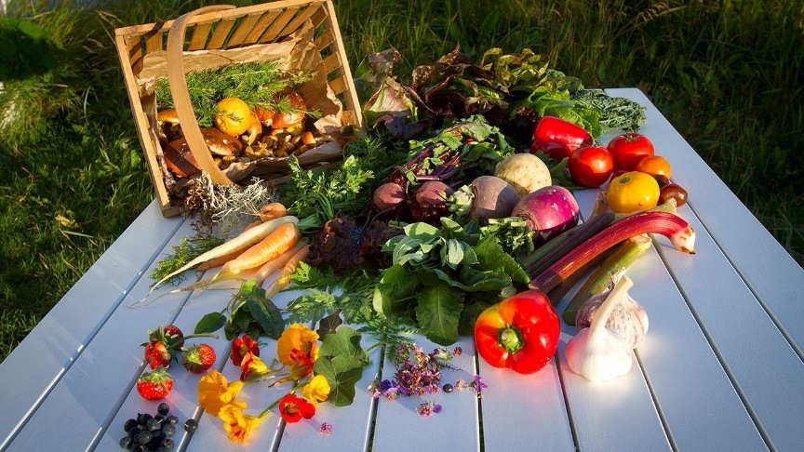
What is the Food Supply Chain?
Definition:
A food supply chain or food system refers to the processes that describe how food from a farm and the sea ends up on our tables.
The processes include production, processing, distribution, consumption and disposal.
YouTube video: https://www.youtube.com/watch?v=Tffcy7269LE

Slide 4
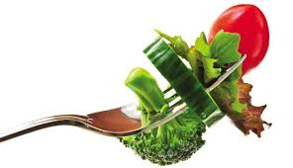
From Sea and Farm to Fork Concept
Sea and Farm to Fork can be defined as “a food chain” in which production, processing, distribution, and consumption are integrated to enhance the environmental, economic, social and nutritional health of a particular place.”
The sea and farm to fork movement often incorporates a form of food traceability ("knowing where your food comes from”).
The movement has arisen attitudes about food safety, food freshness, food seasonality, and small-farm economics
The movement support food policy which promotes serving local food at restaurants, homes, cafés, etc.
Increased production and consumption of local food can improve sustainability in the food value chain.
Notes:
Sea and farm to fork concept – support a food policy which promotes serving local food at restaurants, homes, cafes, etc., preferably through direct acquisition from the producer (which might be a winery, brewery, ranch, fishery or other type of food producer). This might be accomplished by a direct sales relationship, framers market or local distributor.

Slide 5
From Sea and Farm to Fork
Sustainable ‘Sea and Farm to Fork’ agriculture and fisheries contribute to increased economic development, improvements to the environment and social benefits such as better health through eating better quality foods.

Slide 6
From Sea and Farm to Fork
The supply and access to sufficient food (food security) and the safe consumption of food (food safety) are essential to all nations.
Eating with the seasons is a great way for consumers to help cultivate a more resilient, sustainable food system. When you purchase food that's in season from local farms, you're supporting both local farmers and the local economy.
Notes:
Europe is committed to ensuring food security, food quality and food safety for their citizens. This is the essence of the concept “From sea and farm to fork”. This is possible by supporting sustainable farming, quality products, rural development, fisheries and fish farming, food safety and traceability, animal health and welfare as well as antimicrobial resistance. These policies also contribute significantly to generating jobs and growth along the food production chain. The agri-food industries represent today 44 million jobs and 6% of the EU's GDP.

Slide 7
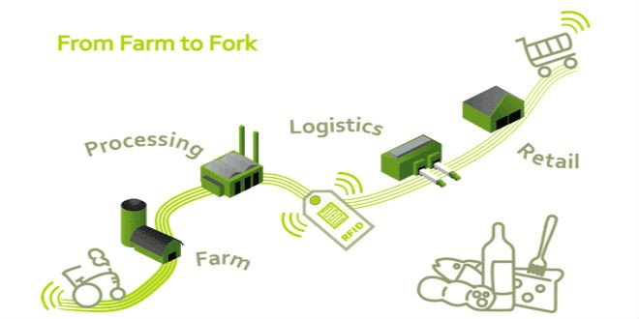
Main Elements of Sustainable Food Production
Producers (Farmers)
Food Processors
Distribution (Logistics)
Retailers
Consumers
To be sustainable you must consider the Environmental, Economic and Social impacts of each element.
Notes:
Sustainable food production – includes standards and assurance about the food production, quality and traceability (knowing where your food comes from) and linking framers to markets/consumers.

Slide 8
Food Producers -Farmers, fisherman
Farmer owns or work on or operates an agricultural enterprise, either commercially or to sustain himself or his family.
Farmer is a person who owns several acres of land and a barn and who raises cattle and grows fruits and vegetables to eat and to sell at a local market.
Organic farming
https://www.youtube.com/watch?v=WhOrIUlrnPo
Notes:
Agriculture and fisheries contribute to economic development and lie at the heart of sustainable development.

Slide 9
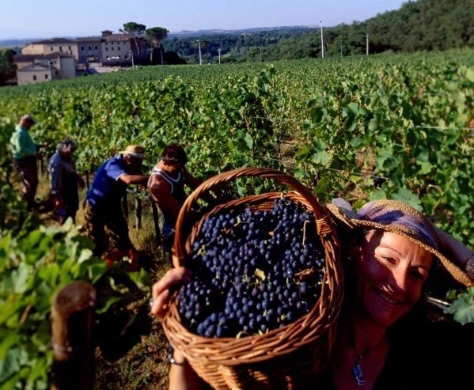
Food Processors
Processing means changing plants or animals into what we recognize and buy as food. Processing involves different steps for different kinds of foods.
Examples
Harvesting of grapes that are then processed and turned into wine.
Or a farmers cows being processed in a factory before being sold as beef to a local butcher.
Notes:
Food processing is the transformation of agricultural products into food, or of one form of food into other forms. Food processing includes many forms of processing foods, from grinding grain to make raw flour to home cooking to complex industrial methods used to make convenience foods.
Primary food processing is necessary to make most foods edible, and secondary food processing turns the ingredients into familiar foods, such as bread.
Tertiary food processing has been criticized for promoting overnutrition and obesity, containing too much sugar and salt, too little fibre, and otherwise being unhealthful.

Slide 10
Distribution (Logistics)
Distribution means getting food from the farm or processing plant to the consumer or a food service facility like a supermarket or restaurant.
It could involve various means of transport such as trucks, planes, ships, vans etc.
This step might involve transporting foods just once, such as from a farm to the local market or could involve long distance transport such as importing foods from other countries.

Slide 11
Retailers
Retailers are those who sell the food products to the consumer.
This could be a local corner shop or large supermarket that sells with thousands of products.
Retailers compete among themselves to attract more consumers competitively selling food products at good-value based on price, quality and service.

Slide 12
Consumers
Consumers are the final entity in the food supply chain. We are all consumers as we all purchase food products to eat.
Consumers are more aware and more concerned about the kinds of foods they eat.
Many consumers like to know where their foods have come from: Is it fresh and of good quality?

Slide 13
Benefits of Using Local Food in Catering Operations
Local food benefits the environment. By purchasing locally grown foods helps maintain farmland, cuts food waste and reduces the carbon footprint (pollution).
Local food supports the local economy. The money that is spent with local farmers stays close to home and is reinvested with businesses and services in your local community. This can lead to job creation.
Local food has more nutrients. Local food has a shorter time between harvest and your table, and it is less likely that the nutrient value has decreased.
Local foods promote a safer food supply. The less steps there are between you and your food’s source the less chance of contamination.
Notes:
In line with UN Sustainable Developmental Goals…. See https://www.youtube.com/watch?v=5G0ndS3uRdo
The Sustainable Development Goals are the blueprint to achieve a better and more sustainable future for all. They address the global challenges we face, including those related to poverty, inequality, climate, environmental degradation, prosperity, and peace and justice. The Goals interconnect and in order to leave no one behind.
Dimensions of Sustainable Development- See https://www.youtube.com/watch?v=pgNLonYOc9s&t=28s

Slide 14
Benefits of Using Local Food in Catering Operations
Often restaurants cannot source all the food they need for dishes locally, so only some dishes or only some ingredients are labelled as local.
Seasonal choices can also mean supporting food that spent less time traveling and in storage, which can significantly cut back on environmental impacts.
Restaurants and hotels will continue to come under increasing pressure from customers, regulators, investors and tour operators to employ green procurement policies.
Great opportunities lie in local food production. Consumers can relate to what they consume and feel the experience how food can relate to land and history.
Notes:
Enhanced food traceability meaning knowing where your food comes from.
In line with UN Sustainable Developmental Goals…. See https://www.youtube.com/watch?v=5G0ndS3uRdo
The Sustainable Development Goals are the blueprint to achieve a better and more sustainable future for all. They address the global challenges we face, including those related to poverty, inequality, climate, environmental degradation, prosperity, and peace and justice. The Goals interconnect and in order to leave no one behind.
Dimensions of Sustainable Development- See https://www.youtube.com/watch?v=pgNLonYOc9s&t=28s

Slide 15
Economic Benefits
You know where the food comes from. When you buy local you know where your food comes from and who grew it.
Locally grown food is full of flavor. When grown locally, the crops are picked at their peak of ripeness versus being harvested early in order to be shipped and distributed to your local retail store.
Increased profit. Increased sales by using local quality foods can in turn increase a businesses profits.
Notes:
The business benefits of sustainable sourcing are:
Improved quality of food and service from suppliers as hotels will improve the relationships with the suppliers. They will also reduce the environmental and health risks and avoid the negative publicity associated with purchasing “problem products”.

Slide 16
Case Studies
1. Sustainability in the Kitchen – Food & Drink
http://www.greenhotelier.org/our-themes/community-communication-engagement/sustainability-in-the-kitchen-food-drink/
2. How to Go Green at Your Restaurant
https://www.thebalancesmb.com/how-to-go-green-at-your-restaurant-2888656
3. Sustainable Food Production
https://www.unenvironment.org/regions/asia-and-pacific/regional-initiatives/supporting-resource-efficiency/sustainable-food
4. Sustainable Food
http://ec.europa.eu/environment/eussd/food.htm

