Slide 1
Unit 4 Trends and Lifestyles
Notes:
The purpose of this presentation is to introduce current trends and explore their impact on catering operations. It will also identify what catering operations can do to adapt to current trends and move towards becoming a sustainable food operation.

Slide 2
“It is not the strongest or the most intelligent who will survive but those who can best manage change.”
Charles Darwin
Notes:
Using the quote on the slide explain the importance of adapting to change and in this case for a business to stay on top of trends that may impact their operations. Note that a huge part of business success is listening and responding to evolving customer needs.

Slide 3
Why important?
A trend is a change or development towards something new or different.
The hospitality industry is subject to numerous trends and these can have an impact on business success or failure.
The ability to recognise trends and adapt to them can help businesses develop and succeed.
Responding to trends can help a business:
Retain competitive edge
Meet existing customer needs and attract new customers
Capitalize on growth opportunities
Comply with the regulatory environment
Notes:
Explain that change is inevitable and the hospitality industry is subject to numerous trends and these can have an impact on business success or failure. Note that trends influence how consumers act and purchase, therefore, businesses need to tailor products and services to meet the needs of consumer trends.

Slide 4
Current trends
Notes:
Activity: Invite the learners to brainstorm some current trends that they are familiar with under the themes below.
Note the following slides will explore further a selection of current trends and lifestyle choices impacting catering operations.
Themes for brainstorm activity:
Food/gastronomic trends
Lifestyle choices
Energy
Technology

Slide 5
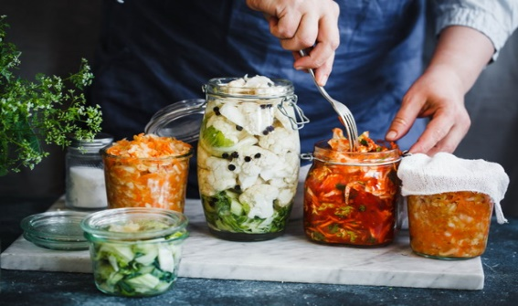
Health and Wellbeing
Growing in importance as people become ever more aware of the importance of a balanced diet.
Alternatives to allergenic foods – eg gluten, diary, nuts
Fermented foods – eg pickling and preserving
Organic & more natural foods – eg avoid sugar, refined grains, trans-fats, nitrates, carcinogens & sulphites
Healthy small plates
Notes:
Introduce Healthy Eating and wellbeing as growing in importance as people become ever more aware of the importance of a balanced diet. This agenda is also influenced by government regulation on allergens, voluntary agreements on calorific values (e.g. displaying calorific, salt, fat and sugar values), and environmental health and food safety schemes like the Food Hygiene Rating Scheme (eg Scores on the Doors).
Explain how, within catering operations, this is leading to an increase in:
Non-allergenic foods - as the number of people with food intolerances and allergies grows. It is more commonplace for catering operations to be catering to special diets. Catering operations need to be aware of all allergies and diets when producing their menus.
Fermented foods – are growing in popularity for gut health including probiotics like kimchi, miso, and kefir.
Organic & more natural foods -more consumers are opting for minimally processed products and avoiding products containing perceived harmful ingredients such as sugar, refined grains, trans-fats, nitrates, carcinogens & sulphites.
Healthy small plates and snacking is also replacing the traditional meal concept.

Slide 6
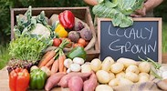
Food Provenance
Refers to the knowledge of where one’s food is sourced.
Local food can provide freshness, reduce food miles, offer benefits to local farmers and their communities and connect consumers with where their food comes from.
Farmer’s markets are making it easier to connect with local producers.
Hyper-local food –food service business that grows produce on their own property.
Case study example - Northern Ireland's Year of Food and Drink 2016 was a celebration and showcase of the local food heritage and produce.
Notes:
Introduce the concept of Food provenance and that consumers are increasingly interested in knowing where one’s food is sourced and the process by which it’s made. Discuss how this is driving increased demand for local products and that local farmers markets are also on the increase.
Explain that food now travels further than ever before with money leaking from local economies and that local food offers a way to: minimise energy use in transportation & storage; increase freshness & quality; strengthen local distinctiveness whilst supporting local food outlets and farmers alike.
Note that one of the best ways to have confidence in the environmental quality of the food we buy is to get to know personally the farmers that supply our food, and find out about the methods they use and the standards they work to.
Buying local also reduces the carbon footprint - food isn't being shipped from one coast to other, using far less fuel than large-scale farm produce.
Another related trend is Hyper local food - a foodservice business that grows produce on their own property, usually in the form of a backyard or rooftop garden
Use the example of The Northern Ireland Year of Food & Drink Celebrations in 2016 to highlight food provenance. Explain this celebration was an opportunity to showcase to the world and visitors the unique food offering in Northern Ireland and increase its reputation in food and drink aswell as building on tourism success.

Slide 7
Ethical/sustainable sourcing
Consumers are looking for trust in the food supply chain
Ethical/sustainable sourcing is the process of selecting suppliers/products which goes beyond economic considerations and takes into account environmental, social and ethical factors as well
A number of certification schemes guarantee defined standards of food safety or animal welfare
Red Tractor in the UK is a farm and food assurance scheme that provides traceable, safe food.
The blue fish label is only applied to wild fish or seafood from fisheries that have been certified to the MSC Fisheries Standard, a science-based set of requirements for sustainable fishing.
Fair Trade certification ensures that farmers are treated justly and paid fairly for their work
Notes:
Explain that consumers today are looking for trust in the food supply chain. This trend is driven by concerns over animal welfare and paying producers a fair price. Define Ethical/Sustainable food sourcing and introduce some of the certification schemes in existence that guarantee standards of food safety or animal welfare and Fairtrade.

Slide 8
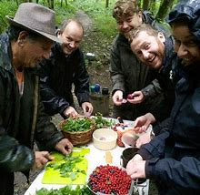
Foraging
Foraging is searching for wild food resources and is becoming popular as people want to know more about our food and how it affects the environment

Slide 9
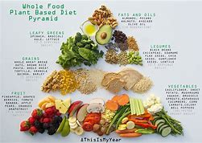
Lifestyle choices
Lifestyle choices reflect changing attitudes towards health, community and the environment.
Veganism – the practice of abstaining from the use of animal products in the diet
Vegetarian – a person who does not eat meat or fish for moral, religious or health reasons
Plant-based eating – a diet that focuses on foods derived from plant sources eg fruit, vegetables, grains, pulses, nuts & meat substitutes such as soy products
Raw foodism – dietary process of eating only/mostly food that is uncooked and unprocessed
Notes:
Define the term lifestyle choices and how consumers –especially millennials [who are considered to be the ones driving the sustainable movement with their lifestyle and behavioural changes] are becoming more concerned about the impact they are having on the earth.
Discuss how a sustainable diet has the least amount of impact to the environment. Illustrate that a high protein, meat based diet is not so good for the environment because meat products have a high carbon footprint compared to a vegetarian diet.
Food-based dietary guidelines around the world encourage the consumption of a more plant-based diet.
Explore what is meant by veganism, vegetarian, plant-based eating and raw foodism.
Veganism is claimed to be the biggest lifestyle movement of the 21st century.

Slide 10
How can businesses respond to shifting consumer values?
Notes:
The next slides identify some actions a catering business might adopt to respond to shifting consumer values.

Slide 11
Increasing importance of millennials
Millennials considered to be the ones driving the sustainable movement with their lifestyle and behavioural changes
They expect the food they eat to reflect their own interests about climate change, animal welfare and social justice issues.
Notes:
Explain that the preferences and habits of millennials will be key drivers of change in the consumer world over the next decade and beyond.

Slide 12
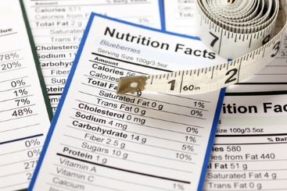
Transparency in labelling
Transparent food labelling means providing information that goes beyond the nutrition facts label.
Increasingly, consumers are demanding to know where their food comes from, how it is made –whether or not it has been genetically modified, and what ingredients are inside.
Notes:
Explain transparent food labelling means providing information that goes beyond the nutrition facts label.
This involves providing information on where food comes from, how it is made –whether or not it has been genetically modified, and what ingredients are inside.

Slide 13
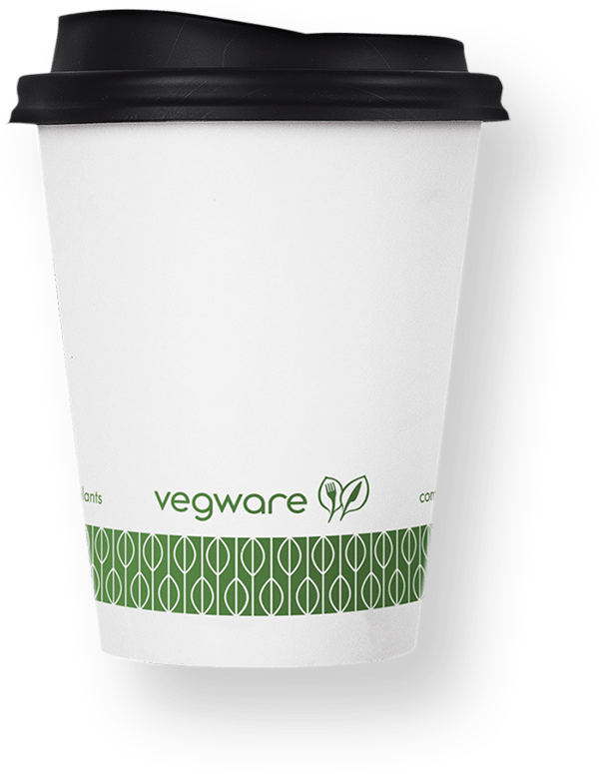
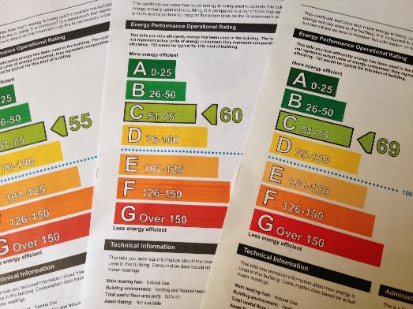
Energy, Water & Waste
Energy efficiency & use of renewal sources
Reducing water use
Reducing waste and composting
Notes:
Explain that the hospitality sector has historically had a dramatic environmental impact through energy and water consumption, use of consumable and durable goods, and solid and hazardous waste creation.
Discuss the move towards more environmentally sensitive management of energy, water and waste in catering operations in response to consumers wanting to engage with more responsible firms.

Slide 14
Training & Technology
Training:
Businesses should train their staff on new trends and lifestyle choices
Food Allergy awareness courses are ever important for staff
Technology:
Touchscreen Food Vendors Digital boxes such as the MooBella Ice Creamery Machine
Online food delivery platforms
Social media promotion consumers seeking visual & shareable content - instagramability!
Contactless payment systems
Notes:
Discuss how training staff on changing trends and lifestyle choices is important.
Discuss how advances in technology continues to shape and change the industry.
These include:
Touchscreen food vendors
Growth in online food delivery platforms with convenience of web & app ordering - facilitate the delivery of food and catering services by matching drivers and delivery cyclists with restaurants.
Rise in social media – with consumers seeking visual and shareable content. Instagramability is placing pressure on need for photogenic presentation of food.
Contactless payment systems as consumers demand more convenience

Slide 15
Taking Action
Name ingredients and where they come from on the menu
Offer a menu featuring locally grown ingredients and artisan products where possible
Use food labelled organic and free-range
Source animal products from certified higher welfare standards
Providing dietary/nutritional information on the menu
Offer healthier options
Reduce food waste
Notes:
Discuss from the slide the actions that a business can adopt to tap into shifting consumer values.

Slide 16
Taking Action
Adopt a sustainable policy
Train staff in principles of healthy eating, waste management
Promote more vegetarian and vegan foods on menu.
Use Fairtrade products where applicable, and promote products which actively support Fairtrade initiatives.
Ensure that animal welfare standards are adhered to for any animal produce purchased
Communicate to customers, staff and suppliers the commitment to serving sustainable food.
Notes:
Discuss from the slide the actions that a business can adopt to tap into shifting consumer values.

Slide 17
Case Studies
Hyperlinks
Made in Belfast
River Cottage
Fish City
Forage Restaurant
Whitbread
LEON & Ikea Food

